Slide 1

Set-Theoretic Model
Generalized Vector Model
Std RegNo.: 2021-CS-164

Slide 2
CONTENTS
Introduction
Backgroud
System Design
Methodology
Result

Slide 3

Generalized Vector Model
Introduction
An advanced IR model that represents documents and queries as vectors in multidimensional space.
Enhances relevance ranking through term weighting and similarity measures.

Slide 4
Background
Generalized Vector Model
Key Concept
Vector Space Model: Represents text as numerical vectors.
Generalized Vector Model: Extends VSM by incorporating term dependencies and improving ranking.
Relevance Ranking: Uses cosine similarity to determine document relevance.
Applications
Search engines, digital libraries, e-commerce platforms, and content management systems.

Slide 5



System Design
Document Indexing
Search Mechanism
Relevance Measure:
Tokenization and normalization of document content.
Creation of term-document vectors with term frequency (TF) weighting.
Search by document name (ignoring extensions).
Search by keywords with relevance ranking.
Cosine similarity for ranking documents based on query-document similarity.

Slide 6
System Design
Example:
Each document is converted into a vector based on term weights. For example, Document A:
Cats: 0.8, Dogs: 0.3
Document B:
Dogs: 0.9, Birds: 0.7
Searching 'Dogs' compares these vectors and retrieves results.

Slide 7
Methodology
Ranking
01
Indexing
03
Read files from a specified folder.
Tokenize content and compute term weights.
Measures similarity between documents and the query to rank and retrieve relevant results.
02
Query Processing
04
User Interaction
Documents and queries are represented as sets of terms, focusing on the presence or absence of terms.
Assigns scores to documents based on their match with the query, enabling prioritized results.

Slide 8
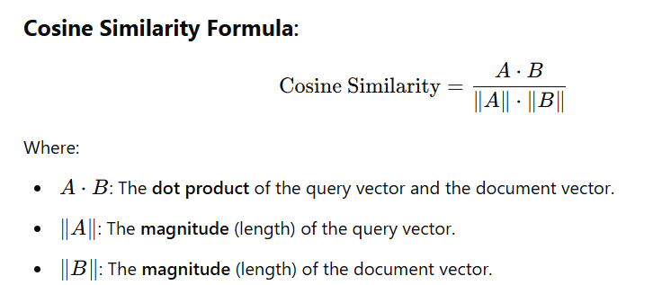
Methodology

Slide 9
Methodology
Example:
Input Query: 'Cats and Dogs.'
Tokenization: Split into Cats, Dogs.
Cosine Similarity Calculation:
Document A: Cats: 0.8, Dogs: 0.3 → Similarity: 0.85.
Document B: Dogs: 0.9, Birds: 0.7 → Similarity: 0.60.
Output:
Document A: 0.85, Document B: 0.60.

Slide 10
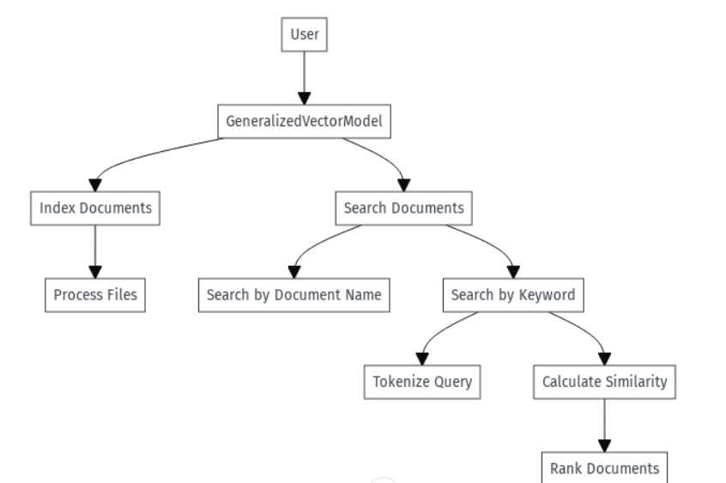
Data Flow Diagram

Slide 11
Generalized Vector Model
Result
Achievements
Accurate retrieval of documents by name, regardless of file extension.
Effective ranking of documents based on keyword queries using cosine similarity.
Robust handling of multiple documents with efficient indexing and query processing.
Name Searching
High Precision and relevance in retrieva; results.
Example:
"Searching 'Dogs' retrieves:
Document A: 0.85, Document B: 0.60.
This ensures Document A is ranked higher as it is more relevant."

Slide 12
Thank You
Std RegNo.: 2021-CS-164

